Slide 1
Lab 3 VAR | IRF Biodiesel-Soybean oil case study
2022 Term 2: FRE 530

Slide 2
Roadmap
Biodiesel – soybean oil case study
Deflate prices
Test for stationarity
VAR
IRF

Slide 3
Packages
Load the following packages
pacman::p_load(here, readxl, dplyr, xts, lubridate, urca, forecast, vars)

Slide 4
Data
Load data_lab3.xls
Prices sheet is the same as last 2 labs
Index sheet is a new sheet
Last week, we established that biodiesel and soybean oil are cointegrated
Engle Granger – each series is I(1)
Johansen Test

Slide 5
VAR modeling
To run a VAR model, we must have stationary data and be in levels
One way to make data stationary is to deflate by a certain index
Energy index for biodiesel
Meals and oils index for soybean oil

Slide 6
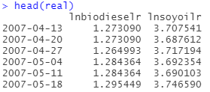
Deflating prices
dataindex <- dataindex %>%
mutate(biodieselr = biodiesel / index_energy * 100,
soyoilr = soyoil / index_ag * 100,
lnbiodieselr = log(biodieselr),
lnsoyoilr = log(soyoilr))

Slide 7
Testing for stationarity
Biodiesel
Lags = 10
Reject null hypothesis of a unit root at all levels
Soybean oil
Lags = 8
Reject null hypothesis of a unit root at the 5% level (type = drift)

Slide 8
VAR
model1 <- VAR(real, p = 10, type = c("const"))
model1

Slide 9
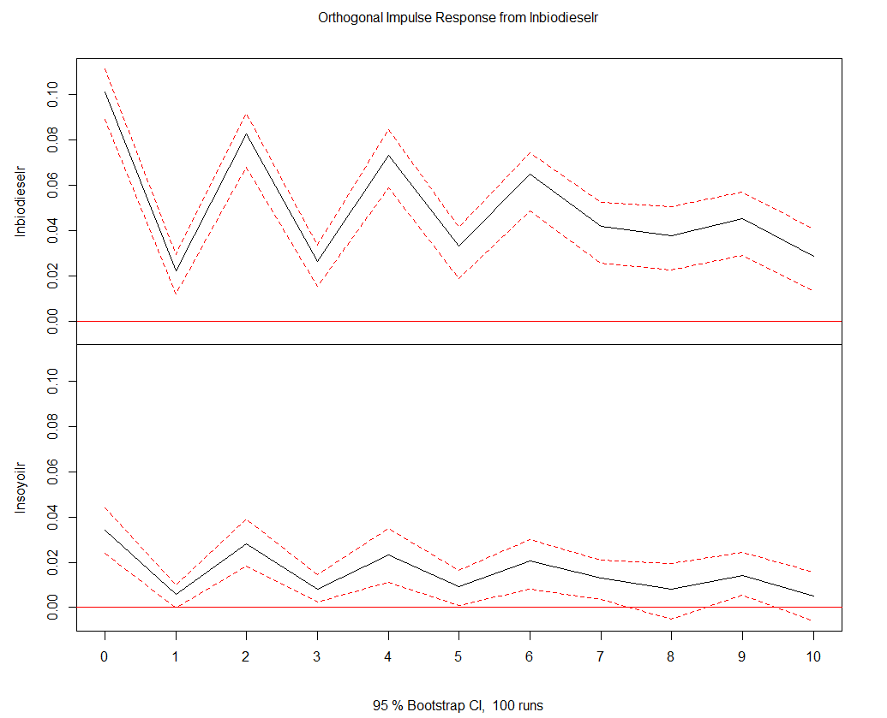
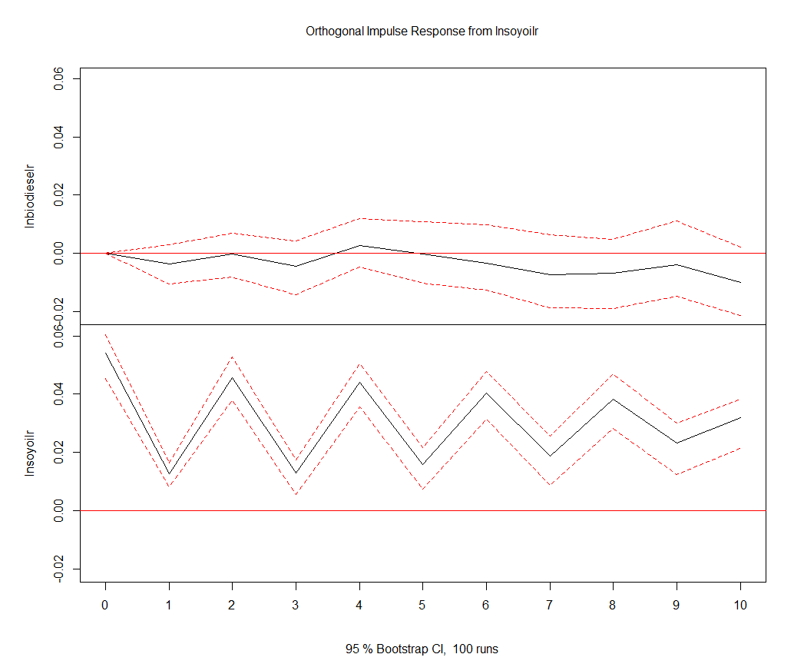
IRFs

Slide 10
IRFs
plot(irf(model1))
irf_bb <- irf(model1, impulse = c("lnbiodieselr"), response = c("lnbiodieselr"), n.ahead = 10)
irf_bs <- irf(model1, impulse = c("lnsoyoilr"), response = c("lnbiodieselr"), n.ahead = 10)
irf_ss <- irf(model1, impulse = c("lnsoyoilr"), response = c("lnsoyoilr"), n.ahead = 10)
irf_sb <- irf(model1, impulse = c("lnbiodieselr"), response = c("lnsoyoilr"), n.ahead = 10)
plot(irf_bb)
plot(irf_bs)
plot(irf_ss)
plot(irf_sb)

